Slide 1

Application and User Studies of Assistive Technologies for the Blind in Navigation
Yeoh Keong Cheng
Nanyang Technological University, School of Mechanical and Aerospace Engineering
3rd July 2018

Slide 2
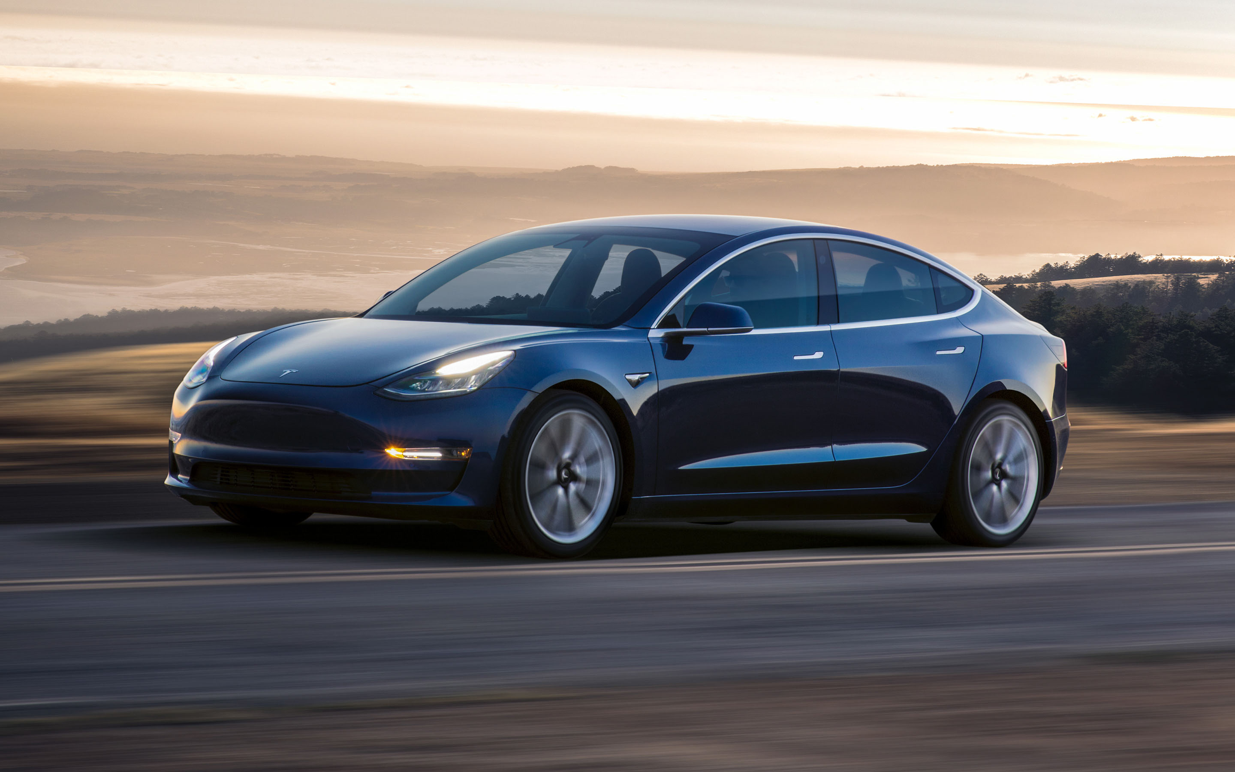

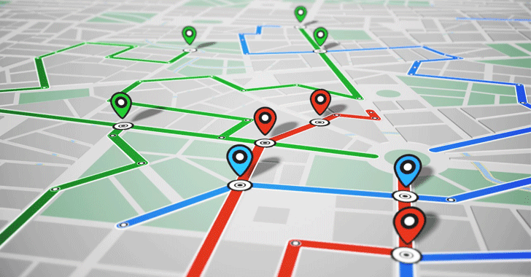
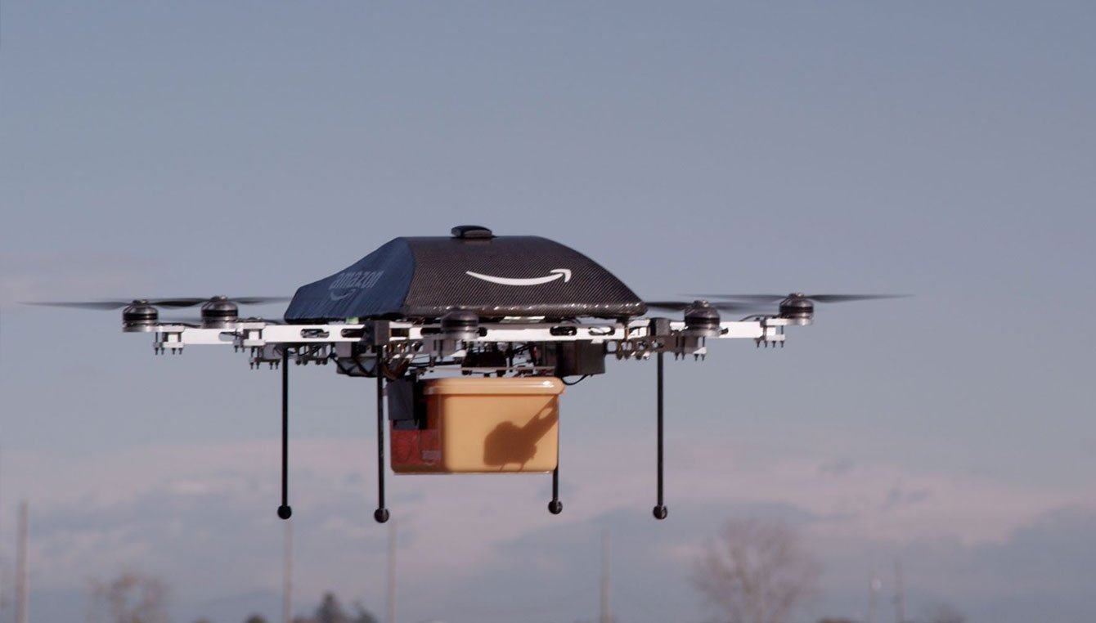
Navigation Technologies

Slide 3
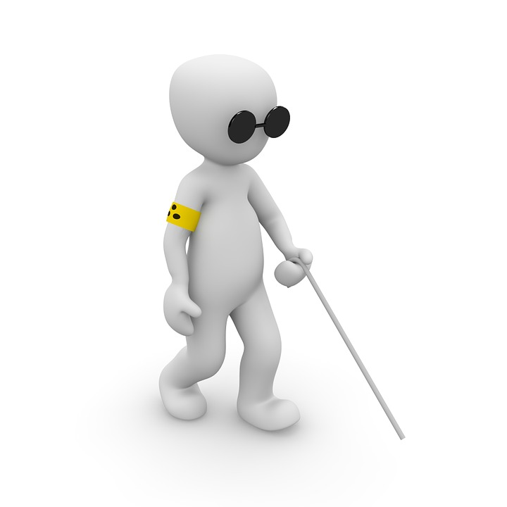
Visual Impairment

Slide 4
Why this project?
Visual Impairment on an increasing trend
Population above 50 year-old have a significant increase in risk of blindness
Aging Population

Slide 5
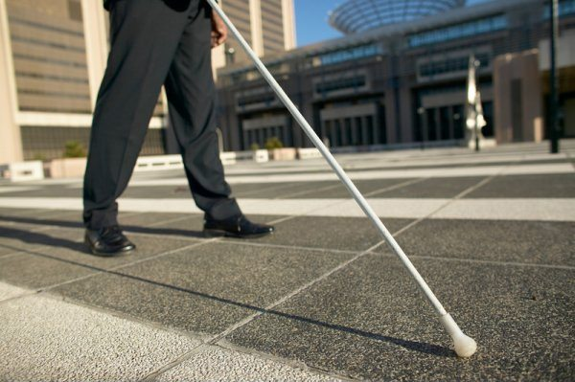
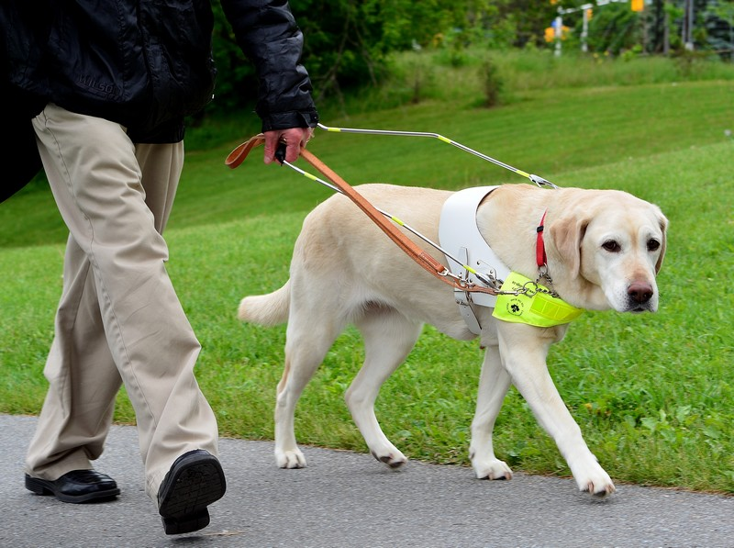
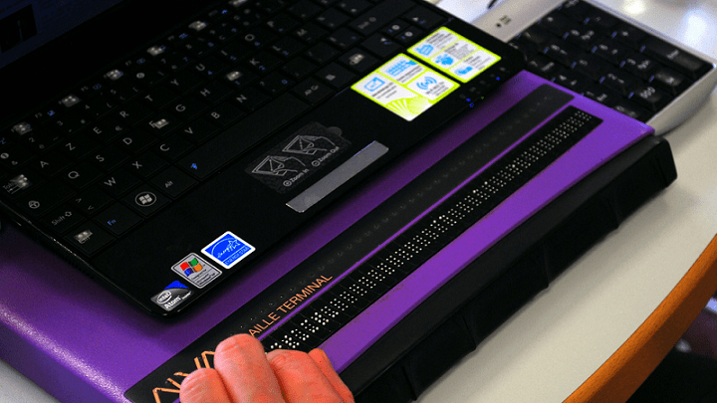
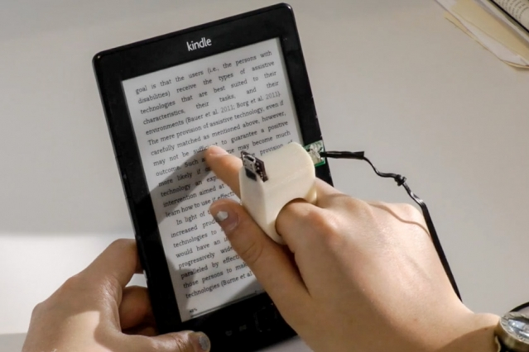
Current Solution

Slide 6
Intelligent White Cane
Object Detection
GPS Direction Finding
Object Recognition

Slide 7
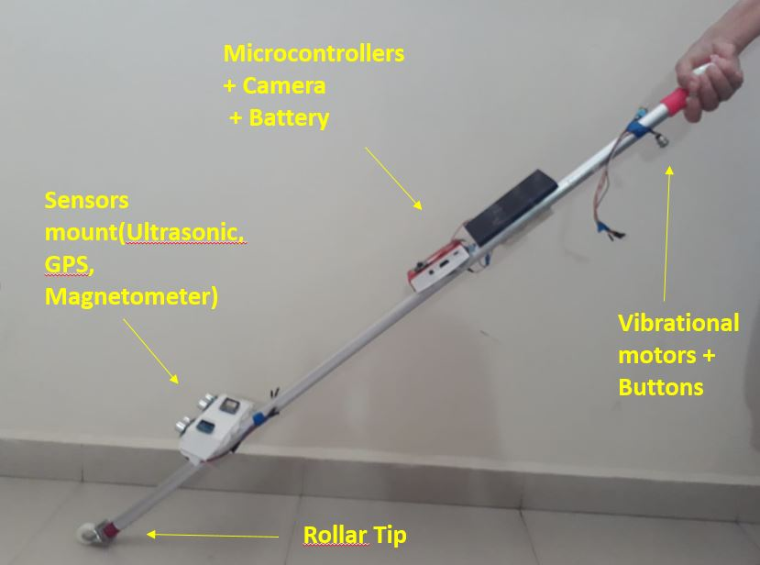
Intelligent White Cane (IWC)

Slide 8
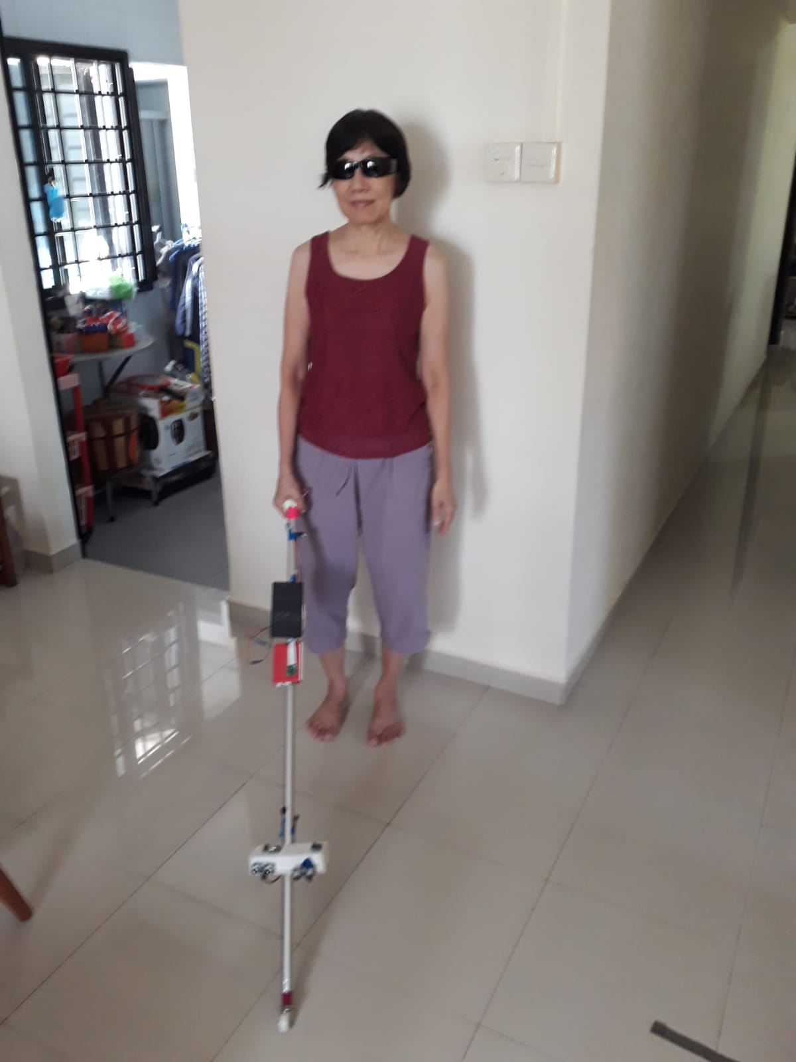
Intelligent White Cane (IWC)

Slide 9
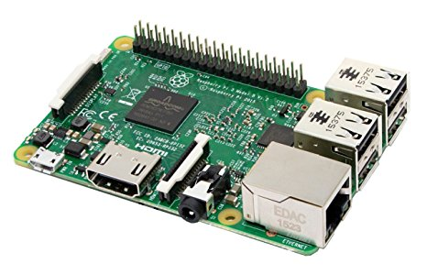
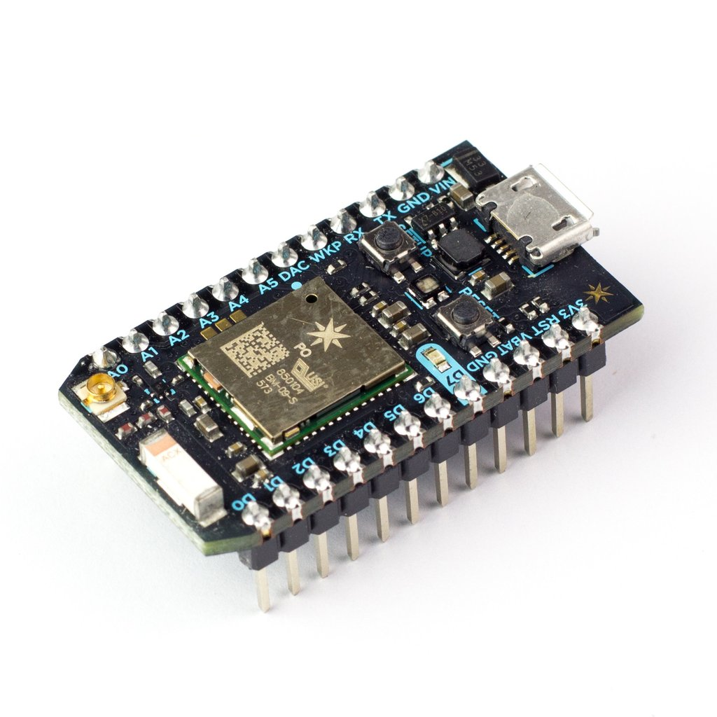
Microcontrollers
Raspberry Pi
Particle Photon

Slide 10
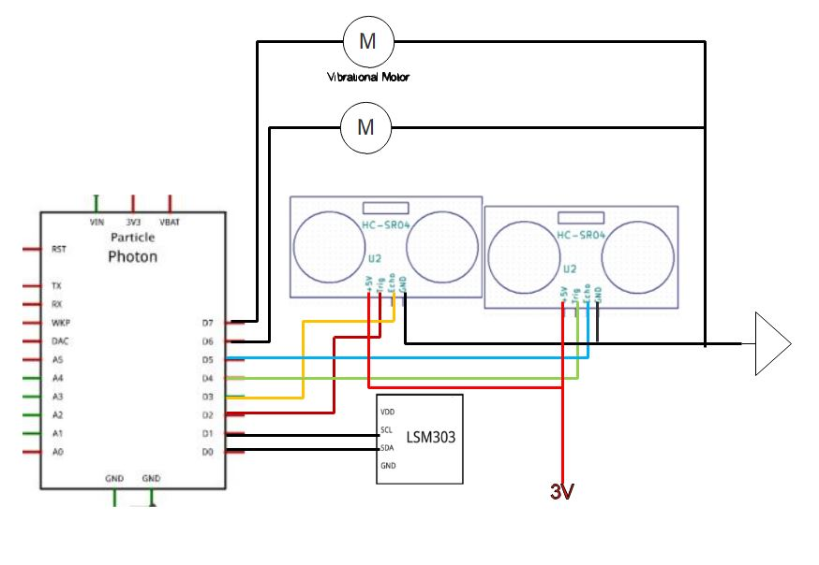
Circuitry

Slide 11
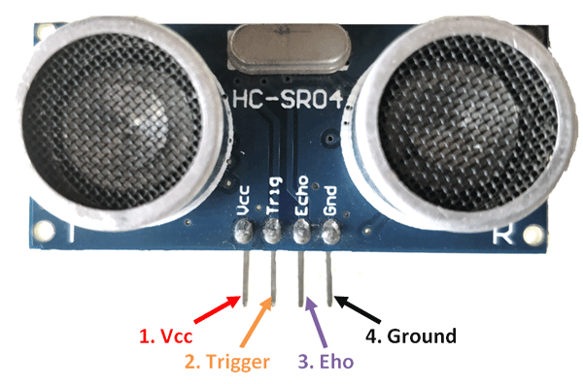
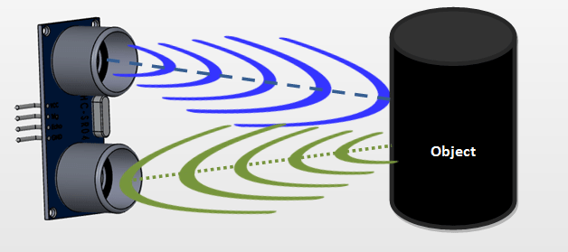
Object Detection
Achieved via Ultrasound
Working range : 4m, 15 ̊̊
d = (t/2) / 343

Slide 12
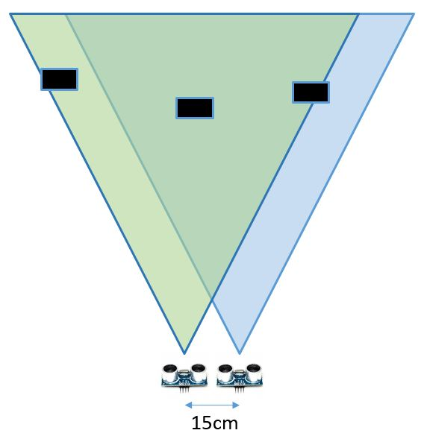
Dual Ultrasound Method
Able to detect relative position of single obstacle
Left, right or centre

Slide 13
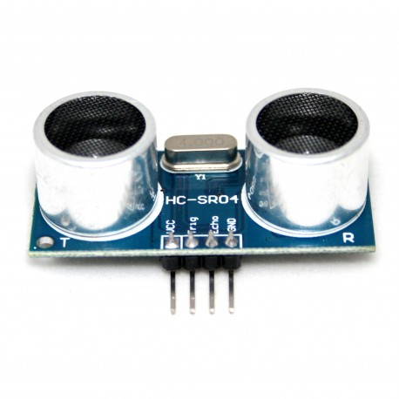
Methodology
1.5m

Slide 14
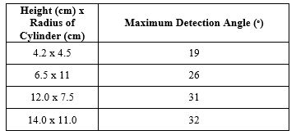
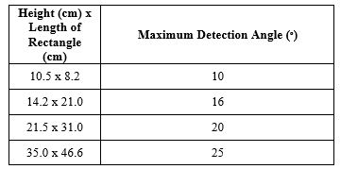
Results

Slide 15
Results
1.5m

Slide 16

Results
Cylindrical object are generally more detectable (why?)
Height of object matters more than width

Slide 17
Limitations
Unable to pin-point multiple obstacle
Have trouble detecting walls

Slide 18
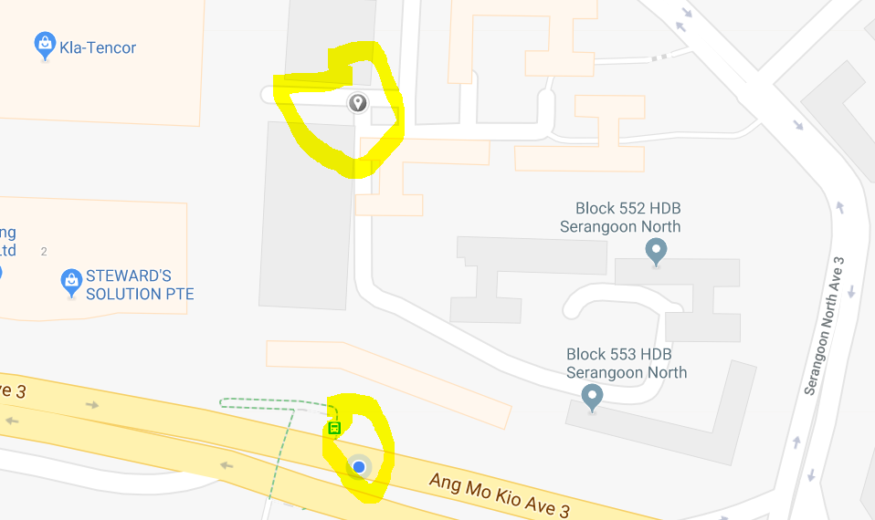
Direction Finding
‘Marked’ Location
Vibration Motor will vibrate either left/right until user faces the right direction
Correct Bearing
Current Location
Current Bearing

Slide 19
Intelligent White Cane (IWC)

Slide 20
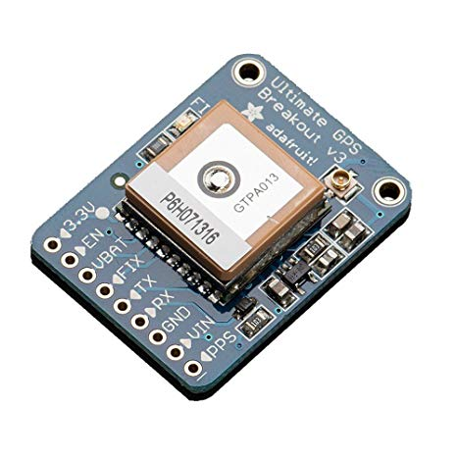
Global Positioning Sytem (GPS)
Adafruit Ultimate GPS
Concerns:
GPS have limited capability indoors and in build-up areas

Slide 21
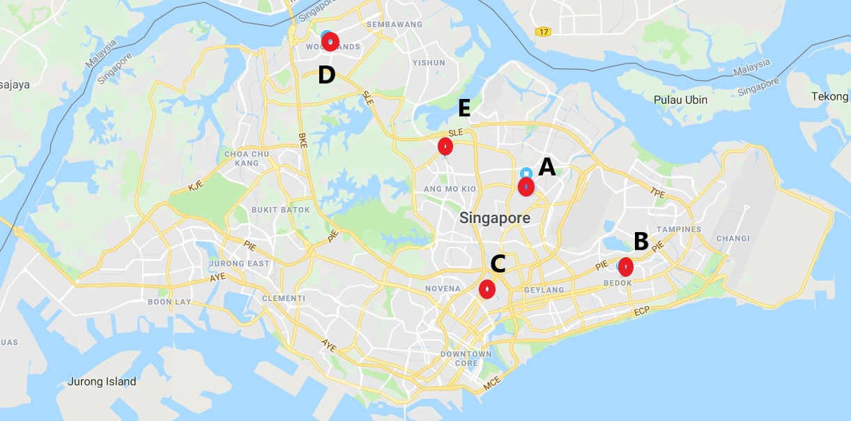
Methodology
2 parameter to investigate
Time require to get a fix
Positional Accuracy of GPS location
5 test site around Singapore

Slide 22
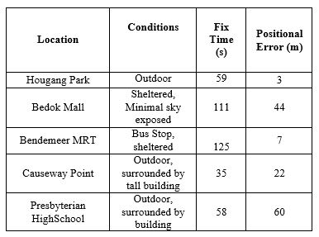
Results
Average Fix Time ~ 78 sec
Very Inconsistent positional error, 3m to 60m

Slide 23
Limitations
Unable to get a fix while indoor
Direction finding has limited accuracy, but may still be useful over long distance

Slide 24
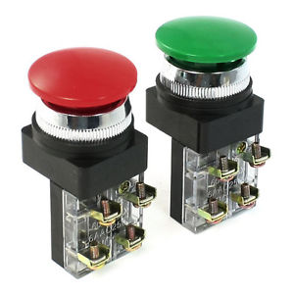

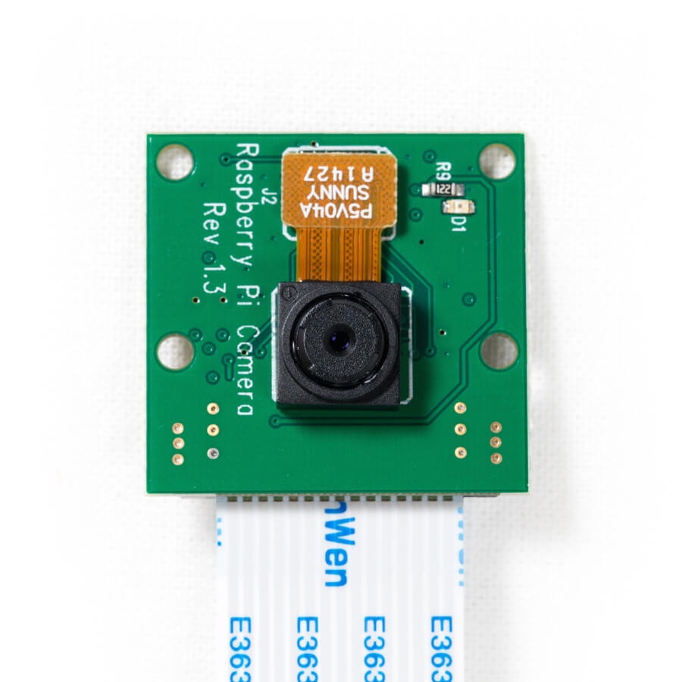

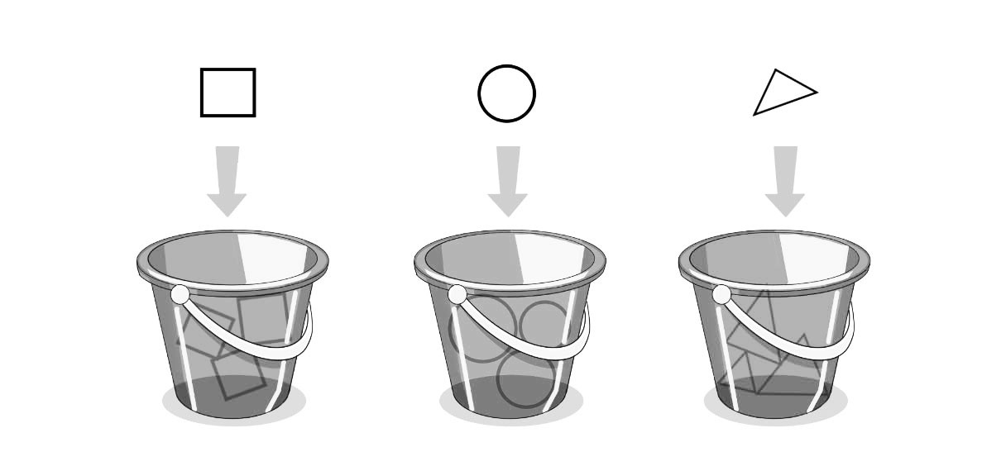
Object Detection
User press a button
Audio prompt tells user what it is
Camera captures an image
Results is sent back to Raspberry Pi
Image is sent to separate CPU for processing + analysis
Object is classified

Slide 25

Bag of Features (BOF)
Object Recognition technique based on Machine Learning
Executed using Matlab software

Slide 26
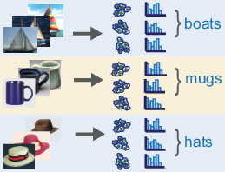
Bag of Features (BOF)
Database of various category of objects are processed.
The computer saves the most distinct feature(words) of each category into a ‘bag of features’ (vocabulary)

Slide 27
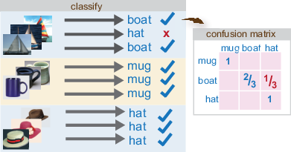
Bag Of Features (BOF)
To categorize a test images, the computer compares the image with all the category. The category with the most matching features is the predicted category.

Slide 28
Methodoloy
Investigate how the accuracy of classification is affected by 3 parameters
Number of Training Images (100x / 200x)
Types of Training Images (cropped / uncropped)
Types of Test Images (cropped / uncropped)

Slide 29
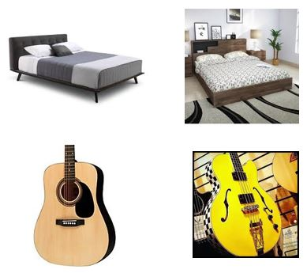
Methodology

Slide 30
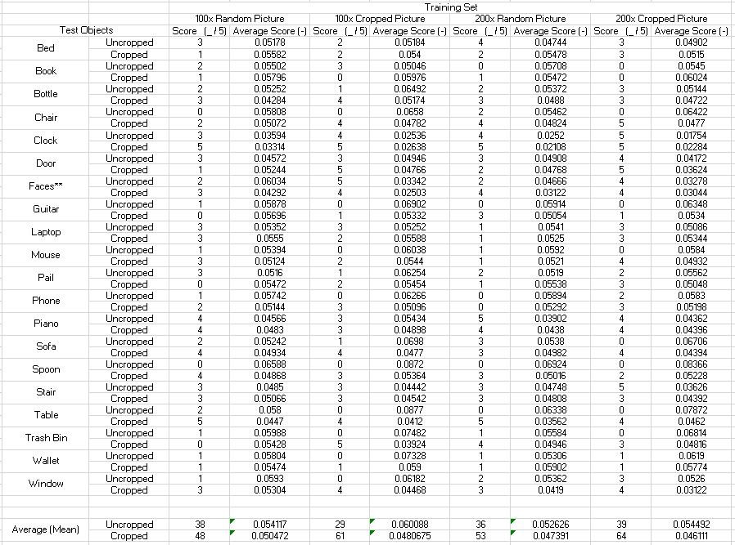
Results
Average accuracy: 46/100

Slide 31
Results
Number of Test Image vs Accuracy
Weak positive correlation
2) Type of Training Image vs Accuracy
Cropped Images are marginally more accurate
3) Type of Test Images vs Accuracy
-Cropped Images are generally more accurate

Slide 32
Limitations
Insufficient for a definitive object recognition capability on the IWC
Shows the importance isolating the image to be classified.

Slide 33
Intelligent White Cane (IWC)

Slide 34
Conclusion
Still a long way to go…
Can perform operations as intended, but largely unreliable as of current design

Slide 35
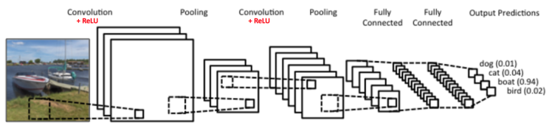
Futher Studies
Wi-Fi Geolocation to aid in positioning technology
Other Object Recognition technique like Convolutional Neural Network (CNN)

Slide 36
THANK YOU!!!

